Slide 1
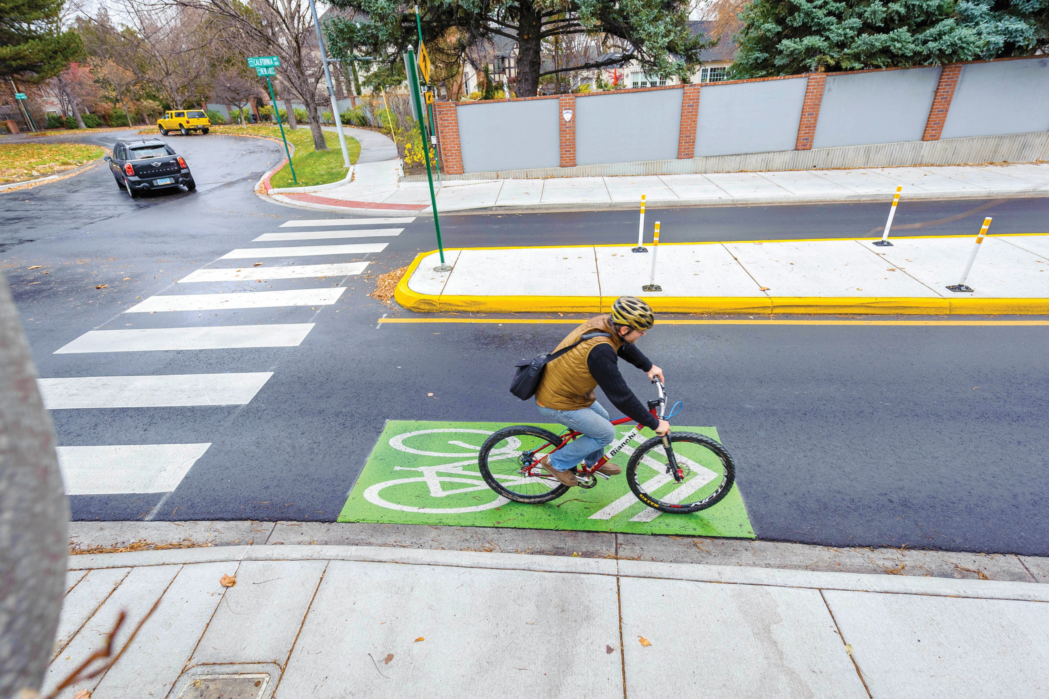
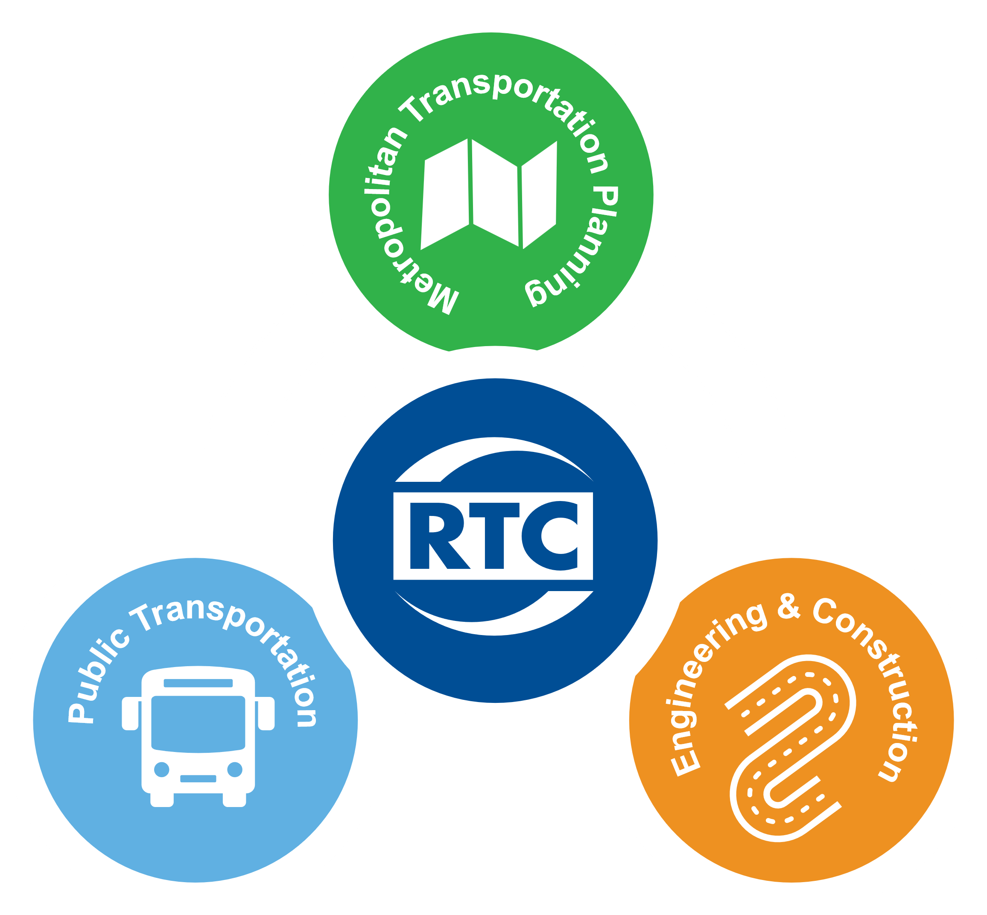
> 2025 Transportation Conference
Multimodal Safety
May 13, 2025
Presenter:
Vanessa J. Lacer, MPA, AICP
RTCWC Planning Director

Slide 2
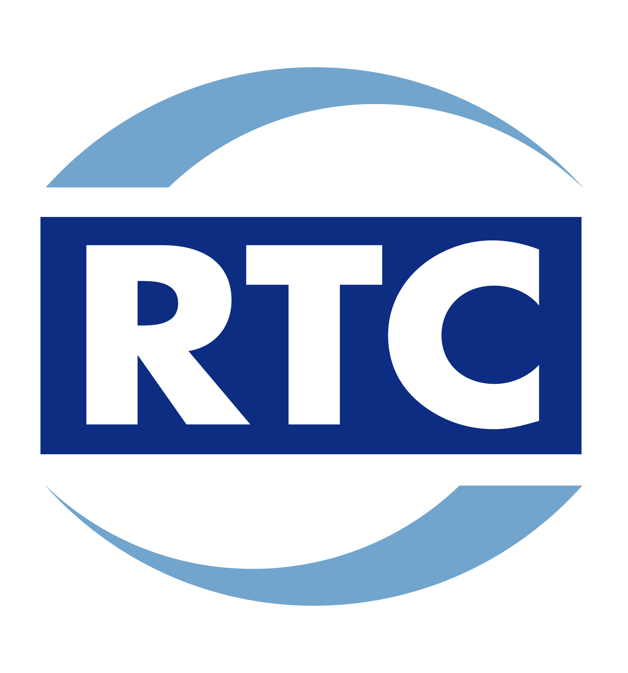
> PRESENTATION OVERVIEW
Multimodal Transportation
Roadway Safety Statistics
Past and Present RTC Multimodal Safety Planning and Projects
Upcoming RTC Multimodal Safety Efforts

Slide 3
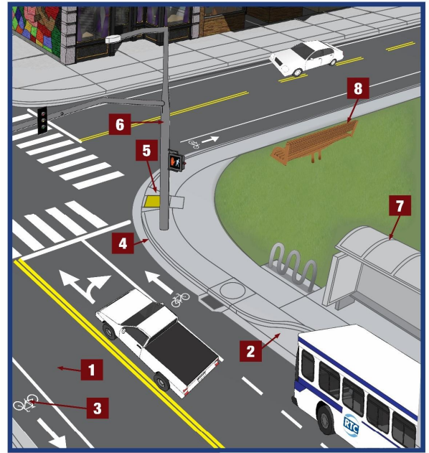
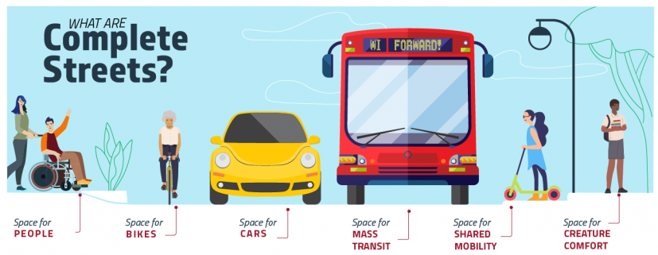
> MULTIMODAL TRANSPORTATION
  Transportation network that supports a variety of transportation methods, and movement between those methods.
  Roadways
    “Complete Streets” approach
      Reduce motor vehicle crashes and pedestrian injuries by slowing traffic and improving infrastructure

Slide 4
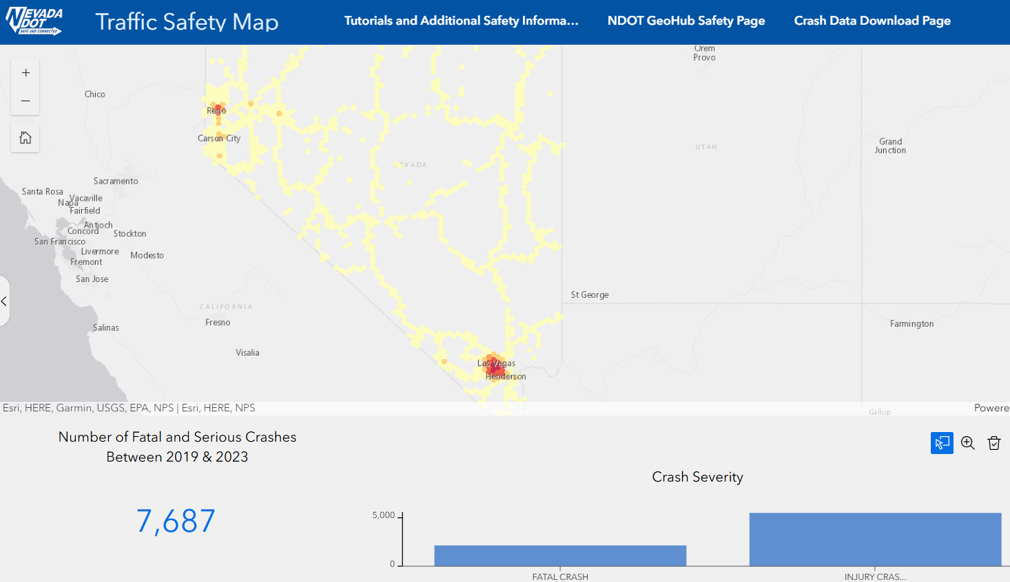
> ROADWAY SAFETY STATISTICS: STATEWIDE
  From 2019-2023, a total of 7,687 fatal and serious injury crashes occurred on Nevada roadways*
1,537 per year, 128 per month, 4 crashes per day causing serious injuries or death
24% of fatalities were pedestrians
* Source: Nevada DOT Traffic Crash Data

Slide 5
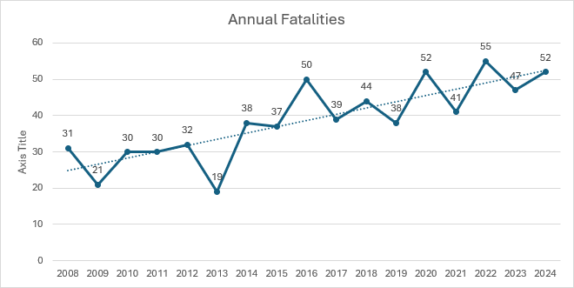
> ROADWAY SAFETY STATISTICS: WASHOE COUNTY
Washoe County Annual Roadway Fatalities
Year-to-year variations
Upward trend over time
Source: Nevada DOT and Nevada Department of Public Safety

Slide 6
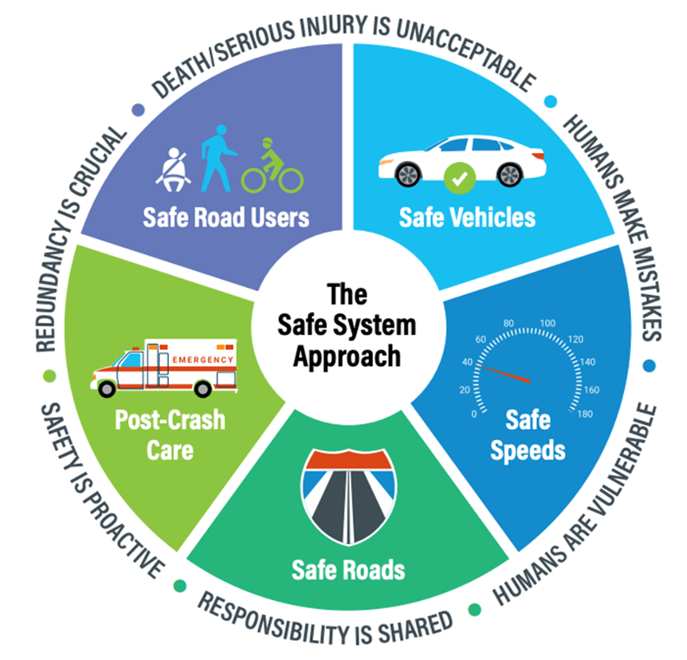
> CURRENT REGIONAL SAFETY PLANNING EFFORTS
Vision Zero Truckee Meadows
2017 Vision Zero Truckee Meadows (VZTM) Task Force was established
  RTC, City of Reno, City of Sparks, Washoe County
2019 Vision Zero Action Plan
  Zero Fatalities by 2030
2022 Vision Zero Action Plan Update
  Updated with HIN and Safe System Approach
More at: visionzerotruckeemeadows.com

Slide 7
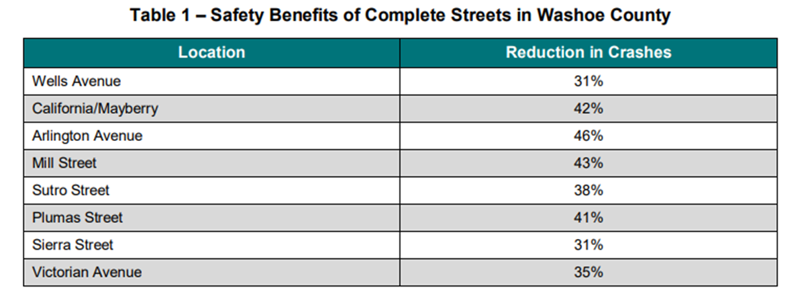
> CURRENT RTC PLANNING EFFORTS
2016 Complete Streets Master Plan
    Long range strategy for complete street treatments
      Retrofit existing roadways, design new roadways as complete streets
    Complete Streets design treatments (lane reduction) have reduced crashes from 31% to 46% on multiple roadways in Washoe County

Slide 8
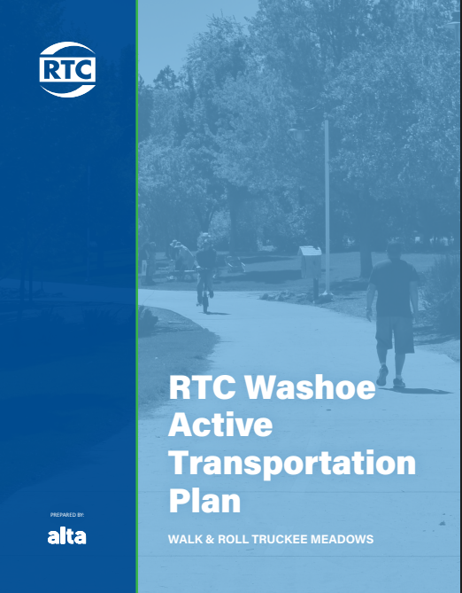
> CURRENT RTC PLANNING EFFORTS
Active Transportation Plan
2024 Active Transportation Plan
  Updates/Replaces the 2017 Bike Ped Master Plan
    Establishes the Active Transportation Program
      Dedicated funding
    Establishes Neighborhood Network Planning framework

Slide 9
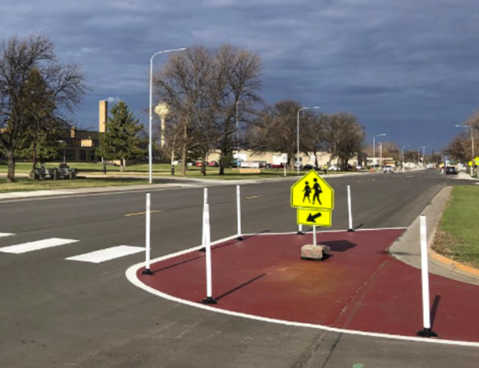
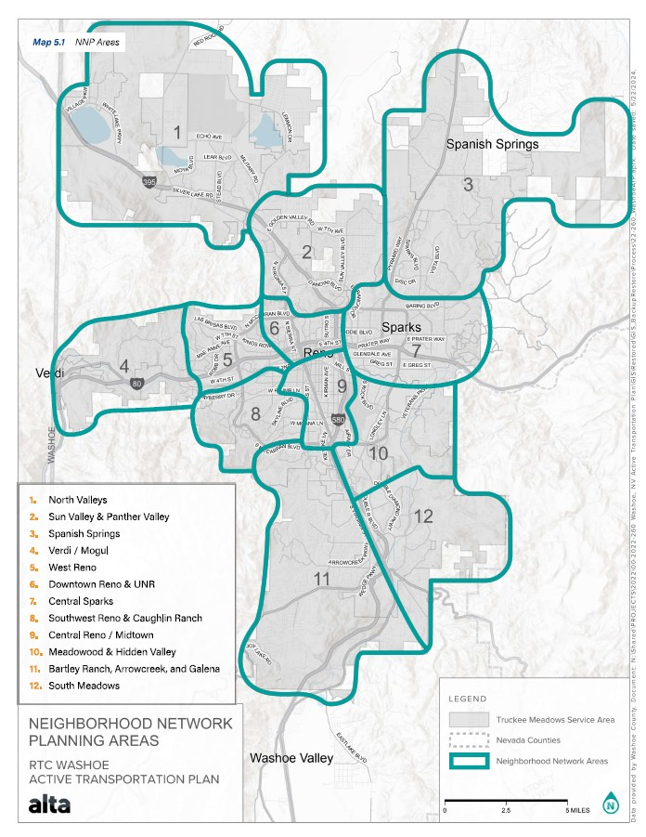
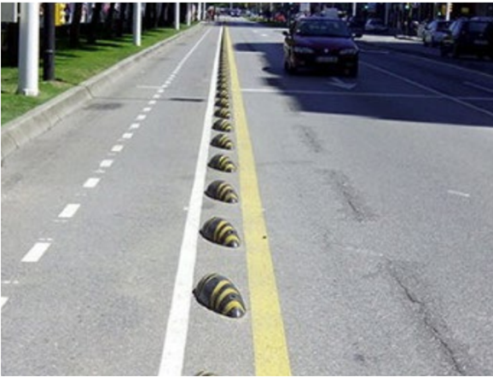
> CURRENT RTC PLANNING EFFORTS
Neighborhood Network Plans
12 plans in 6 years
Bicycle and Pedestrian Focused
Safety, connectivity
Data driven approach
  Bicycle Level of Stress
  Pedestrian Experience Index
Identify quick build projects for implementation through AT Program

Slide 10
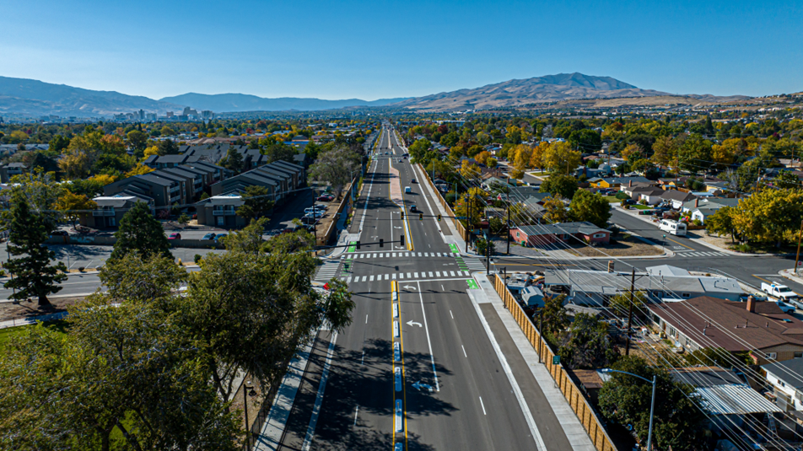
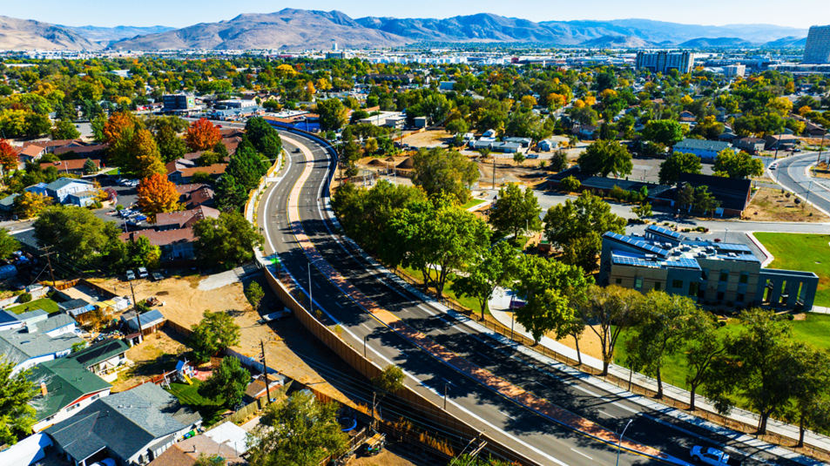
> RECENTLY COMPLETED RTC PROJECT
Oddie Wells Project
Reconstruct 3.2 Miles of Roadway
6 Miles of Raised Cycle Track and ADA Sidewalks
490 New Trees, 433 New Lights
Privacy Walls in Select Areas
Completed in September 2024
$52 Million

Slide 11
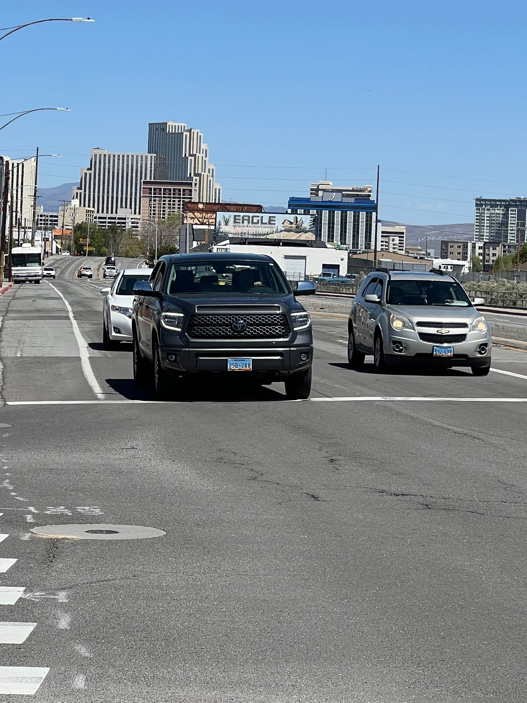
> CURRENT RTC PROJECT
West Fourth Street Safety
Keystone Avenue to McCarran Boulevard
  Roundabout at Stoker Avenue
  Roundabout at Summit Ridge Drive
  Lane Reductions
  Multiuse Path
  Pavement Rehabilitation
  $26.5 Million, Highway Safety Improvement Program (HSIP) funding
  Out to bid fall 2025

Slide 12
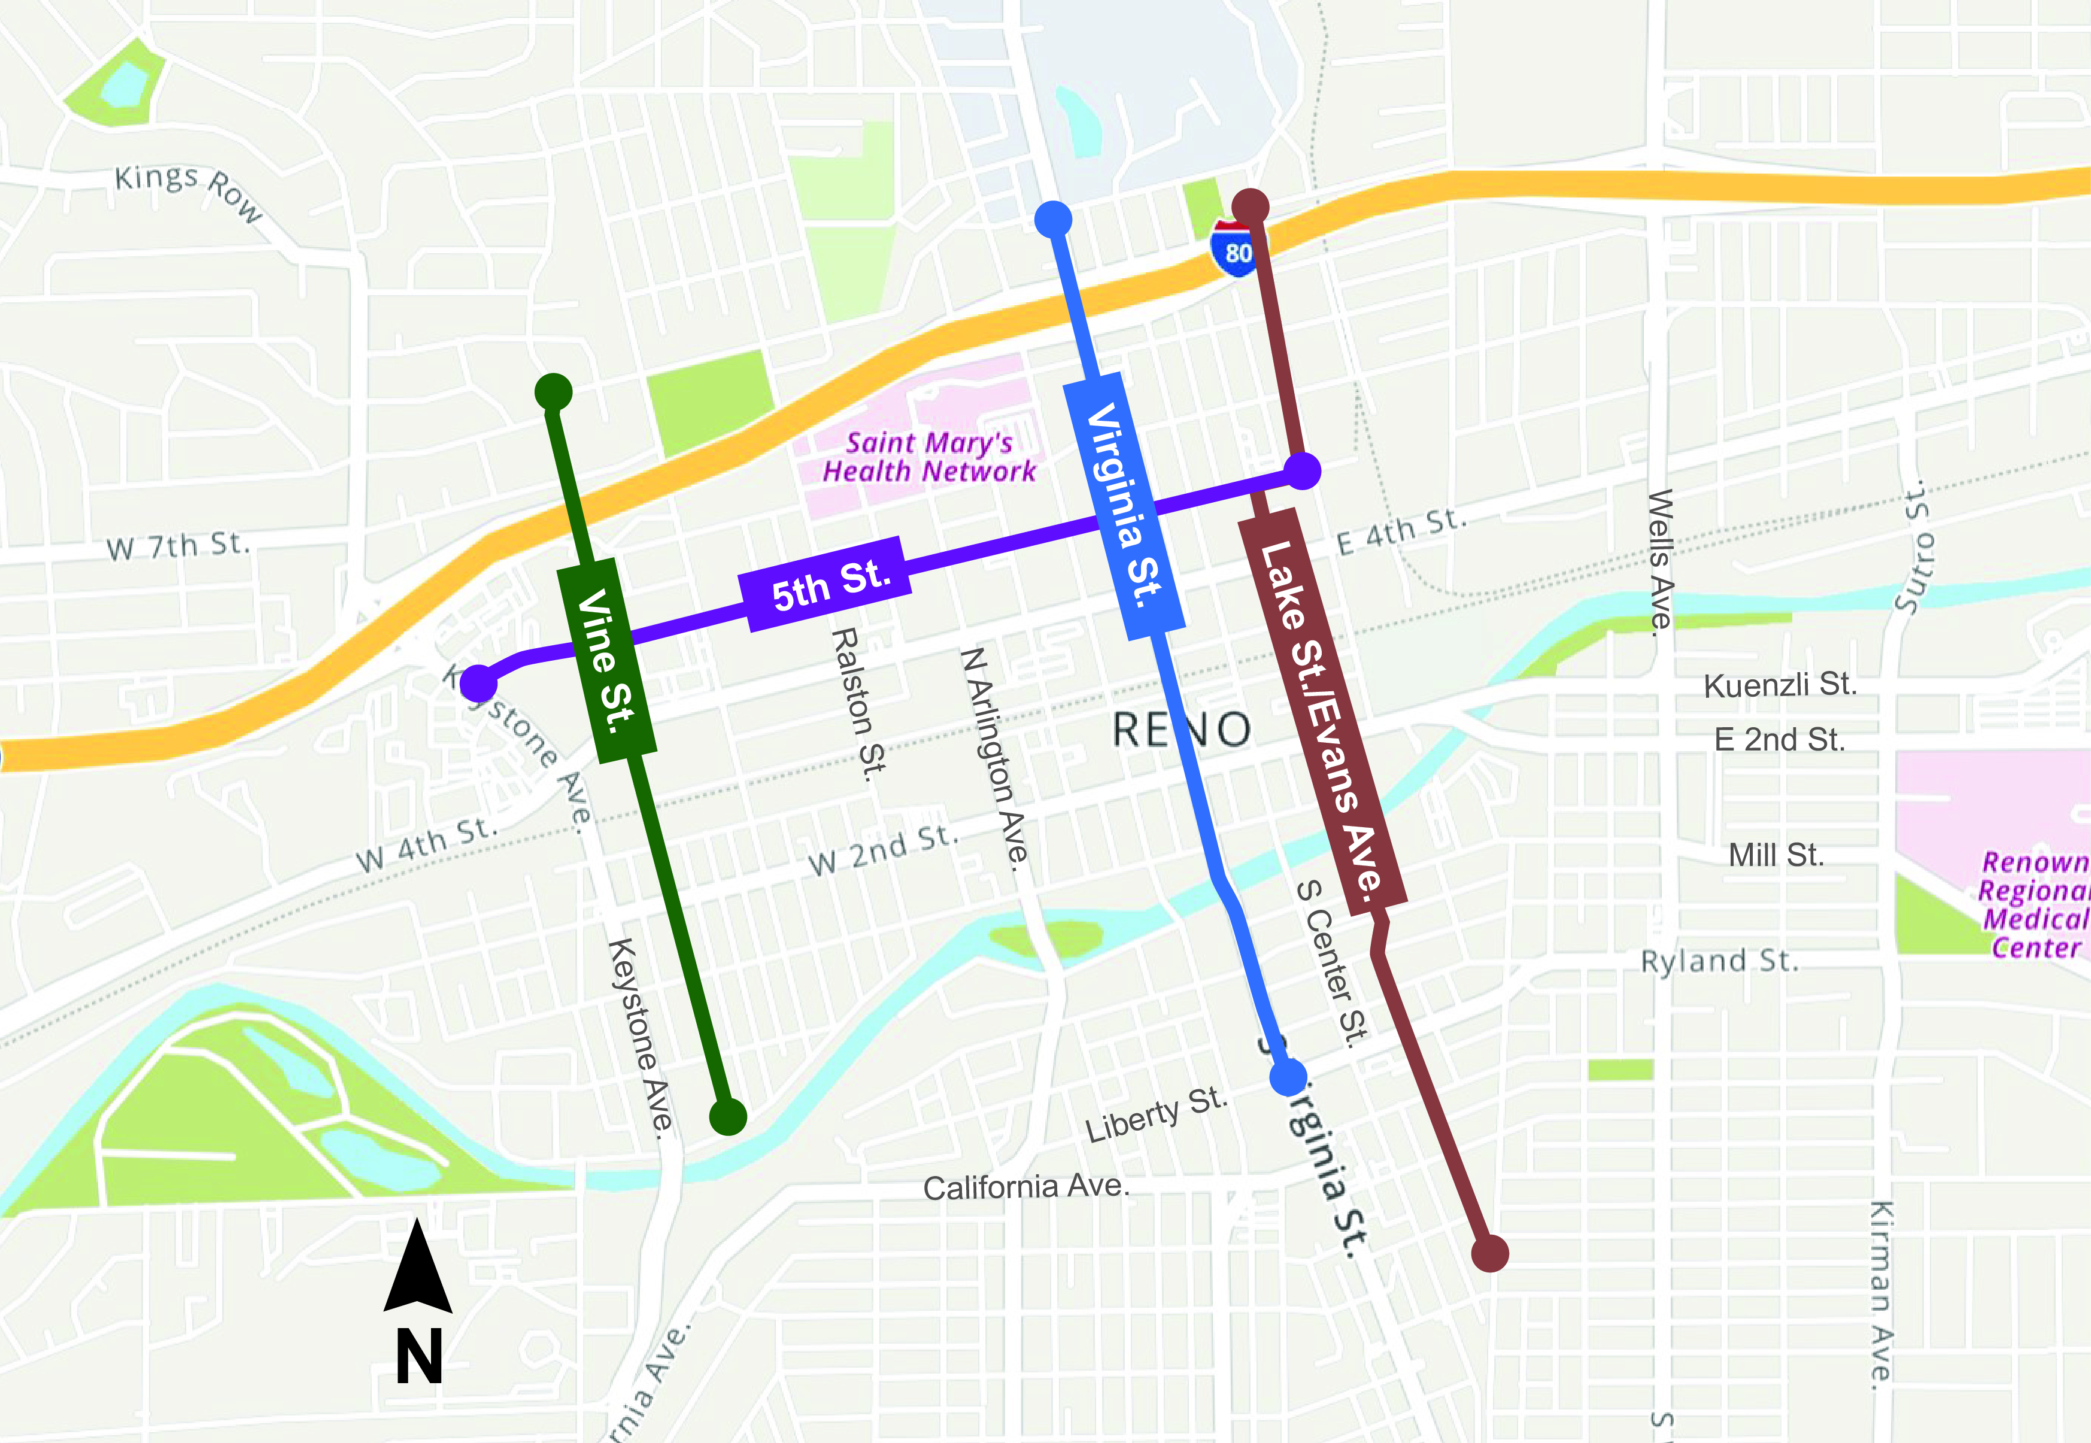
> CURRENT RTC PROJECT
Biggest Little Bike Network
Four Identified Routes
  Vine Street
  Virginia Street
  Lake Street
  5th Street
Improvements for Biking and Walking
Connect Midtown/Old Southwest to Northside of I-80, Especially the University Area
Construction expected 2026

Slide 13
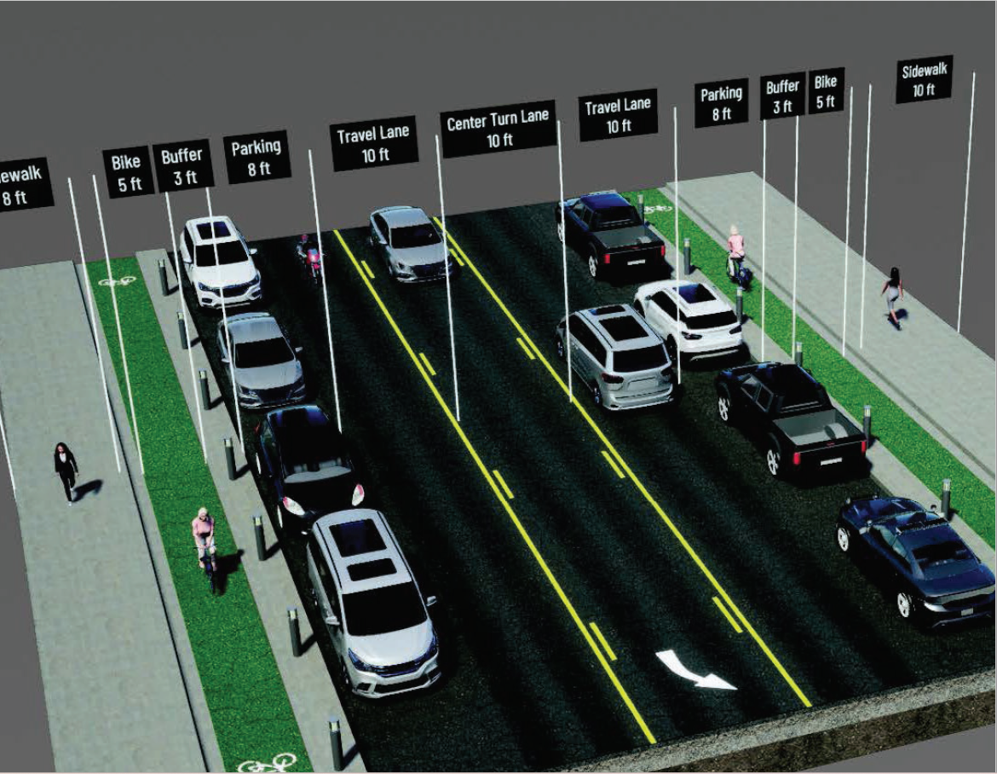
> CURRENT RTC PROJECT
Sixth Street for All
Virginia Street to 4th Street
Improve Safety for Drivers, Bicyclists and Pedestrians
  Construct Eight-Foot, High-Visibility Sidewalks
  Streetlight Enhancements
  Protected Five-Foot Bike Lanes with a Three-Foot Buffer
  Reduce From Four Lanes to Two Lanes
  Center Turn Lane and Parking
Part of High-Injury Network
Received $8.9 Million Safe Streets & Roads for All (SS4A) Grant
Construction expected 2027

Slide 14
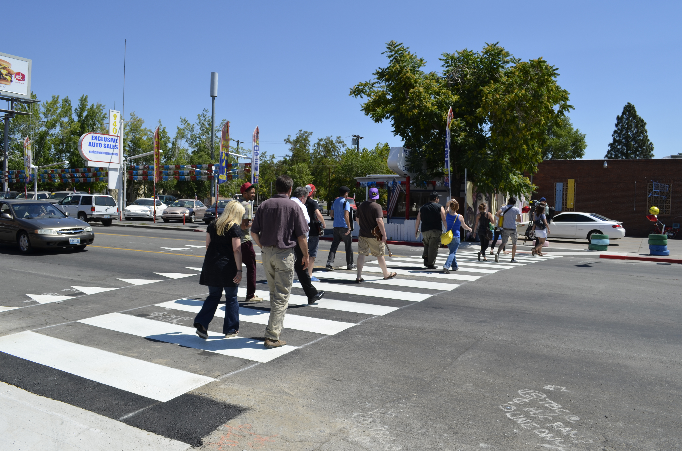
> UPCOMING RTC SAFETY PLANNING EFFORTS
FY 2026- 2027
FY 2026
  Neighborhood Network Plans #3 and #4
  Rock Blvd Corridor/Area Study
  Kirman/Locust/Wells/Taylor Corridor/Area Study
FY 2027
  Neighborhood Network Plans #5 and #6
  Silverada/Wedekind/Clear Acre/Sutro Corridor/Area Study
  West 7th/Kings Row/Keystone Corridor/Area Study

Slide 15
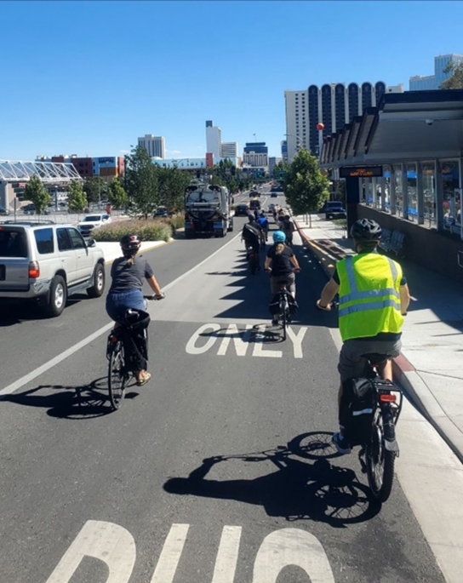
> UPCOMING RTC SAFETY PLANNING EFFORTS
Regional Safety Action Plan
Awarded a $1.2 million Safe Streets & Roads For All grant to complete a Regional Safety Action Plan
Will update/replace the 2022 Vision Zero Plan
Will update the HIN with additional data and enhanced safety analysis, and develop a predictive tool
Currently in contract approval phase

Slide 16


THANK YOU
Vanessa
Lacer
Planning Director
vlacer@rtcwashoe.com
775-335-1901
Building A Better Community
Through Quality Transportation
rtcwashoe.com/neighborhood

